Slide 1
Virtual vs. In-Person DPS Meeting 2021 Considerations as discussed on April 22, 2021 within the DPS Committee
Compiled by Amy Mainzer, DPS Chair

Slide 2
Statement of Values – What do we hope to achieve from a DPS meeting?
Whether in-person or virtual, we want to have a meeting that is:
Scientifically productive and engaging
Fosters collaboration and networking opportunities
Equally accessible to the entire planetary science community
Safe (2 aspects relevant here):
Risk of attending not significantly above average risk of traveling to a typical science conference)
Holding conference does not significantly increase community risk

Slide 3
Background
The DPS Committee negotiated a schedule for notifying AAS of our decision to go virtual or in-person based on the AAS staff’s need for adequate time to plan the meeting, which is October 3-8, 2021.
The agreed-upon date for the DPS Committee to make the decision was April 22, 2021.

Slide 4
Minimum Threshold for Having In-Person Meeting
Need to be sure travel restrictions at major planetary science employers will be lifted in time for people to book travel (NASA, NSF, national labs, universities, etc.) – this needs to be before the abstract submission deadline
What we know of as of today (April 22, 2021):
NSF is not anticipating allowing conference travel until no earlier than Oct 1
We do not have a clear statement from NASA on when non-mission-critical travel will be allowed
Examples of universities: UArizona & ASU still requiring permission from university administration for travel on a case-by-case basis; unclear when this will change

Slide 5
Pros of In-Person
Pros:
In-person meetings are what we have always done up until 2020
DPS community likes them
They maximize scientific collaboration for attendees
Best networking opportunities for job seekers
Lots of expertise in running in-person meetings in AAS staff
Ability to focus and concentrate due to physical separation from home, regular work site

Slide 6
Cons of In-Person
Could represent a public health hazard (for both attendees and the greater community) due to continued spread of virus and its variants
Many uncertainties about what sort of accommodations would need to be made to minimize public health risk & comply with regulations
We will not be “back to normal” – must account for changes in interactions & expectations
Financial: could lose up to $90k in hotel and venue costs (see financial slide)
AAS might require proof of vaccination to attend: unclear legal/ethical issues
Hard to predict what attendance would be, given uncertainty in:
National and local restrictions against large international meetings
Vaccination rates in adult population (DPS attendees and community at large)
Surging local & international infection rates & unknown international travel rules
Vaccine effectiveness against mutations
Vaccination and in-person schooling for children, who are largely not eligible for vaccination yet
Peoples’ interest in conference travel after a long period of isolation from family, delayed medical appointments, fear of viral exposure in large group settings, more pressing deferred work meetings, etc.

Slide 7
Pros of Virtual
Safe: no concerns of excess illness or death due to virus
Accessible to people across many different continents, and to groups (i.e. students) who may not normally attend an in-person meeting due to cost concerns
Per our member meeting exit survey, virtual offers improved significantly accessibility for hearing impaired
Able to pre-record talks and make them available after the meeting*
Enables attendees to ask questions via Slack, Zoom chat*
*Note that these features are potentially – but not necessarily – available at an in-person meeting
Not as expensive for attendees: no travel costs, reduced registration costs
Able to build on successful virtual meeting held in 2020
Environmental impact significantly lower than in-person

Slide 8
Cons of Virtual
Zoom fatigue: people may not attend because they are tired of virtual meetings
Could represent a financial loss if we do not guess attendance correctly and set registration rates to match
2020 virtual meeting lost $9k
Losses could be more: potentially up to $40k (see financial slide)
Decreased opportunities for scientific collaboration and networking, especially for job seekers
Requires a good internet connection for full participation
For some, harder to focus due to distractions at home

Slide 9
Options that were ruled out for 2021 meeting
AAS staff says we cannot combine the DPS meeting with the winter 2022 AAS meeting due to uncertainties in space restrictions (covid, fire requirements)
We do not presently have a “full hybrid” meeting cost model that is affordable (essentially we would pay nearly full costs for both a virtual meeting and an in-person meeting, which would likely substantially increase meeting cost). AAS staff says that we could reasonably stream plenaries, make Slack available, and use iposters for an in-person meeting, but this is not an equivalent experience content-wise to being at the meeting in person.
Many logistical and financial questions must be answered to implement a viable “full hybrid” meeting, in which virtual attendance offers the same access to content as in-person. This is anticipated to take more time than we currently have available for planning the 2021 meeting. We can consider it for next year if necessary.

Slide 10
Estimated Worst-Case Financial Scenarios
In-Person:
Use 2018 Knoxville meeting as proxy for expenses.
Assume 50% of normal attendance.
We are liable for up to ~200 room-nights at the prevailing rate; unclear what this is, but we can use the estimated per diem of $209/night as a benchmark. = $40k.
Conference center: $50k.
Assume same fixed costs from that meeting, adjust all other income/costs that are proportionate to meeting attendance
Net loss in these circumstances is about $73k; assume we lose half the hotel block ($20k) →total -$93k
Does not include any other expenses incurred due to accommodating covid (e.g. extra space rental required to comply w social distancing guidelines, PPE, or cleaning services; assumes any potential legal fees are absorbed by DPS) → greater cost uncertainty
Virtual:
There were about 380 full registrants at the 2020 meeting ($160/person) and 250 students ($75/person) for a total income of $178k.
2020 meeting costs were about $187k. Some costs scale proportionate to the number of attendees, so assume this drops costs to $148k.
If we assume that 25% fewer people attend the 2021 meeting due to zoom fatigue (drop income down to $, and assume that we lose half our sponsors (-$25k) then total income drops to $109k →total -$40k

Slide 11
Conclusion
After thorough discussion spanning multiple meetings over several months, and involving the SOC, LOC, and VOC Chairs, a vote was taken by the DPS Committee, per the DPS Bylaws.
The DPS executive leadership (Committee and Officers) has voted to hold a virtual 2021 meeting. Vote was conducted by email.
3 votes for in-person
10 votes for virtual
This is consistent with the recommendation of AAS Executive Officer Dr. Kevin Marvel, who recommended a virtual meeting in a meeting with DPS leadership in late March, 2021.
Amy will notify Elizabeth Scuderi and Kevin Marvel, so that they can begin negotiations with the hotel and conference venue.
Once negotiations are concluded, we can notify our membership.
We will publish these slides, which document the decision-making logic and process that we followed.

Slide 12
Consequences of Going Virtual
Need to negotiate with hotel and conference center: AAS says they need 2-3 weeks
Expectation is that there will be no financial consequence if we move Providence to 2027 (based on Spokane experience)
Once AAS staff completes negotiations with hotel, we can notify our membership

Slide 13
By the Numbers: April 22, 2021
The following slides show some resources the DPS Committee considered to get a sense of the US and global COVID status.

Slide 14
Who Can Be Vaccinated?
Roughly 25% of U.S. has been fully vaccinated to date
Children under 16 cannot be vaccinated (only Pfizer available to 16+; Moderna and J&J are 18+)
Pfizer has completed clinical trials for 12+ years; expected to request emergency approval soon
Moderna & Pfizer clinical trials began in March for children (6+ months)
source: Washington Post vaccine tracker, April 22, 2021

Slide 15
Vaccine Hesitancy
The U.S. is expected to run out of adults who are willing to take the vaccine in the next 2-4 weeks
Source: Axios, April 21, 2021

Slide 16
Vaccine Hesitancy
Vaccination rate has declined by 9% since last week (source: Washington Post vaccine tracker)

Slide 17
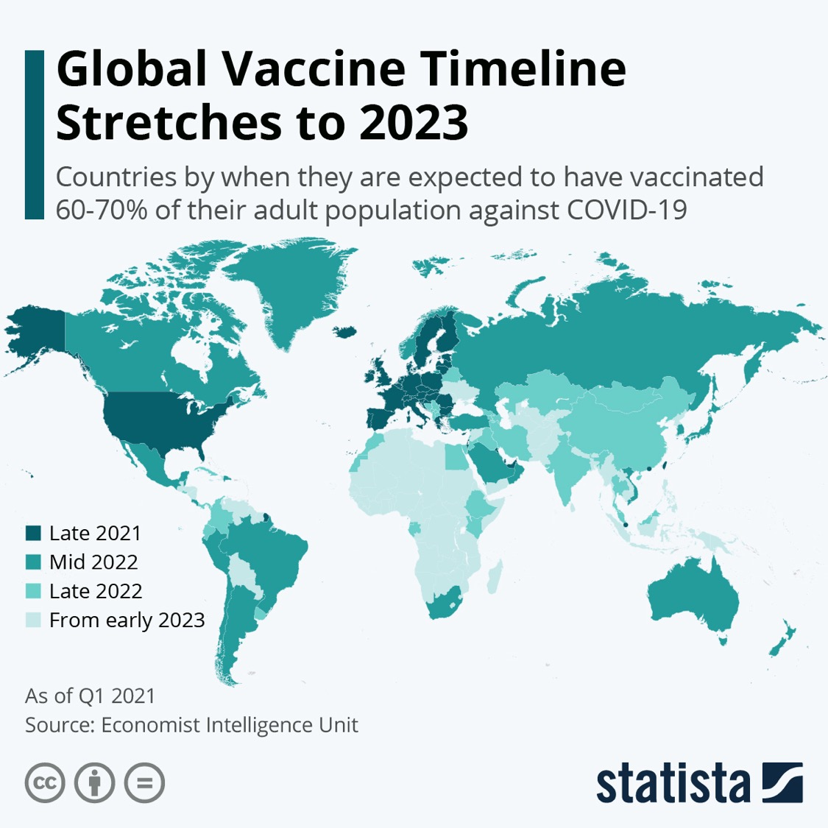
The World
Vaccines are not yet widely available worldwide
Source: Statista

Slide 18
Infections are currently surging globally
Bloomberg News April 18, 2021: Global Covid Cases Hit Weekly Record Despite Vaccinations

