Slide 1
Addressing Mental Health in Planetary Science:
Big and Small Steps to Creating an Environment that Supports Well Being
David Trang, Ph.D., MACP
Space Science Institute
Hoʻokō Rising Scholars Program, Hawaiʻi Pacific University

Slide 2


I am a planetary scientist with a focus on surface processes and composition.
I am also a pre-licensed mental health counselor with a specialization in clinical mental health counseling.
Current job is helping under-resourced undergraduates adjust to college and create new skills and behaviors to perform their best in school (i.e., equity).
About Me

Slide 3
Importance of Addressing Mental Health in Planetary Science

Slide 4

There is a mental health problem in planetary science.
Everyone is affected by this mental health issue in the community.
Research quality and efficiency suffers with this mental health issue.
Mental Health Affects Everyone

Slide 5

Almost everyone in planetary science works with several people (most papers include multiple authors).
76% of planetary scientists say their anxiety/depressive symptoms makes it at least somewhat difficult to do their work, take care of things at home, or get along with others (Trang et al., 2024) .
29% said very difficult and 9% said extremely difficult.
Example of Mental Health Affecting Research

Slide 6

Imagine working with someone who is grieving (lost a loved one).
Why are they not doing their best work? Would you tell them to work through it or go home?
Their minds are occupied with recent events that is causing their grief.
Example of Mental Health Affecting Research

Slide 7

Memory and mind is occupied with distracting thoughts.
Short term memory can only hold so much information (like RAM on a computer).
Research requires short-term memory to interpret data, develop research ideas, and solve problems (i.e., executive functioning).
Children are still developing short-term memory, plays a role in limited perspective taking.
Example of Mental Health Affecting Research

Slide 8

In the case of grief, without all available resources in short-term memory, it becomes difficult to interpret data, solve problems, and develop research ideas.
Distraction affects a person’s work, their productivity, and their quality.
You may rely on them for data calibration, interpretation of data, doing their part of the project, writing a portion of the paper etc.
Example of Mental Health Affecting Research

Slide 9

Replace grief with clinically marked anxiety or depression.
Often, people do not talk about their symptoms of their feelings at work.
With people trying to work through it, it can affect the research results, interpretations, or even the proposals.
Because we all work together and rely on each other, it will affect everyone’s work.
Example of Mental Health Affecting Research

Slide 10
Studying Mental Health in the Planetary Science Community

Slide 11

Mental Health in Academia
Mental health is a concern when behavior, emotions, and/or thoughts causes distress to a person’s home, work, and social life.
Poor mental health can adversely affect research quality and production, physical health, and social health.
Mental health concerns in academia has increasingly been gaining attention (e.g., Evans et al., 2018; Levecque et al., 2017; Vance et al., 2021).

Slide 12

IRB-Approved Mental Health Survey
Goal: Determine whether a mental health concern is present in planetary and what are the major contributors.
Two different surveys, fall of 2022 and fall of 2023 with ~300 participants in each.
Used an anxiety, depressive, and stress assessments (DASS-42, GAD-7, PHQ-9).
Survey includes demographic questions.
Rate potential factors contributing to symptoms and reasons for considering leaving the field.

Slide 13
Prevalence of Anxiety in Planetary in 2022 and 2023
(Trang et al., 2024)
(Warren et al., 2021)
(Evans et al., 2018)

Slide 14
Prevalence of Depression in Planetary in 2022 and 2023
(Trang et al., 2024)
(Ettman et al., 2021)
(Evans et al., 2018)

Slide 15
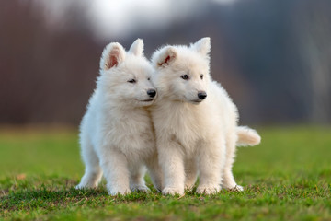
Differences Between Identities
Trang et al. (2024) showed statistically significant differences between demographic groups:
Female participants experience greater severe stress and anxiety symptoms than male participants.
People of color participants experience greater anxiety symptoms than White participants.
LGBTQ+ participants experience greater anxiety, depressive, and stress symptoms than non-LGBTQ+ participants.
Marginalized populations experience greater severities in mental health symptoms than the dominant groups.

Slide 16

Mental Health is a DEI issue
It is possible that a portion of symptoms are a product of the greater societal and cultural issues.
We still need to care about mental health because academia can lessen the mental burden on marginalized groups.
Working in planetary could also be a protective factor that lessen the impact of greater societal and cultural issues.

Slide 17
Comparison between Mission Participants and Non-Participants

Slide 18
Top Contributors to Anxiety among Planetary Scientists

Slide 19
Top Contributors to Depression among Planetary Scientists

Slide 20
Contributor Differences Between Gender

Slide 21
Contributor Differences Between LGBTQ+ and non-LGBTQ+

Slide 22

Focus on one thing at a time
Plenty to work on, but rushing can be overwhelming.
Later, discuss some small things we can say to address feeling undervalued or underappreciated.
Also, discuss big policies that may help with mental health based on mission participation results.

Slide 23

… what other things can we look forward to?
Accommodating neurodiversity (differences in how we experience the world and react to it).
Managing imposter syndrome.
Addressing substance use (alcohol and drugs).
Creating a positive work environment in mission teams.

Slide 24
Plan to Improve Mental Health in Planetary Science

Slide 25
There is a plan!
Individual
Community
Rapport Building
Intake Assessments
Treatment Planning
Homework
Changing behavior
Community Relationship
Research and Surveys
Workshops and Psychoeducation
Homework and Helping Others
Change the culture

Slide 26

Change the culture
In individual therapy, many times, improvement requires change, such as behavioral and cognitive changes.
What is it when a community of people need to make a change? It is a culture change, a change in our customs.
That means everyone has to commit to change ...
Be patient with cultural changes!

Slide 27

Workshops and psychoeducation
We go about making positive changes by running workshops and giving talks that teach what needs to change.
Policy changes among funding institutions and research institutions.
Integrating small changes in our conversations, behaviors, and habits.
Small changes lead to major outcomes, do not underestimate simple habit changes.

Slide 28

Doing homework
Effort is needed to make these cultural changes.
Homework does not mean leading a group or setting up time-consuming meetings and workshops.
Homework can mean as little as changes in your own habit and thoughts.
Homework can also mean just having a conversation of change with colleagues and students to promote change in them.

Slide 29

The importance of rapport
In counseling, rapport or the positive relationship between the therapist and client is one of the most important aspects to making therapy work.
As much as I would love to know everyone and help the field, I cannot build these relationships alone.
Academia and planetary science, we’re all connected!
You are better at sharing these needed changes with colleagues and helping them make the change than me!

Slide 30
Suggested Big Policy Changes

Slide 31
Comparison between Mission Participants and Non-Participants

Slide 32

Mental Health Differences in Mission Participation
Hypothesis 1: Mission participation creates a sense of belonging to a group.
Hypothesis 2: Mission participation give early career scientists/students exposure to multiple mentors (greater chance of having a positive mentor).
Perhaps a combination of both hypothesis 1 and 2.

Slide 33

Addressing Hypothesis 1
Creating sense of belonging is important to human health and human longevity.
One of the most important variable to a long life is socialization rather than isolation.
Mission teams create a sense of belonging to a group, something bigger than self, working together to create meaning (answer large science questions).
Policy change: Creating more teams, such as missions, SSERVI, astrobiology may help students feel part of a social group.

Slide 34
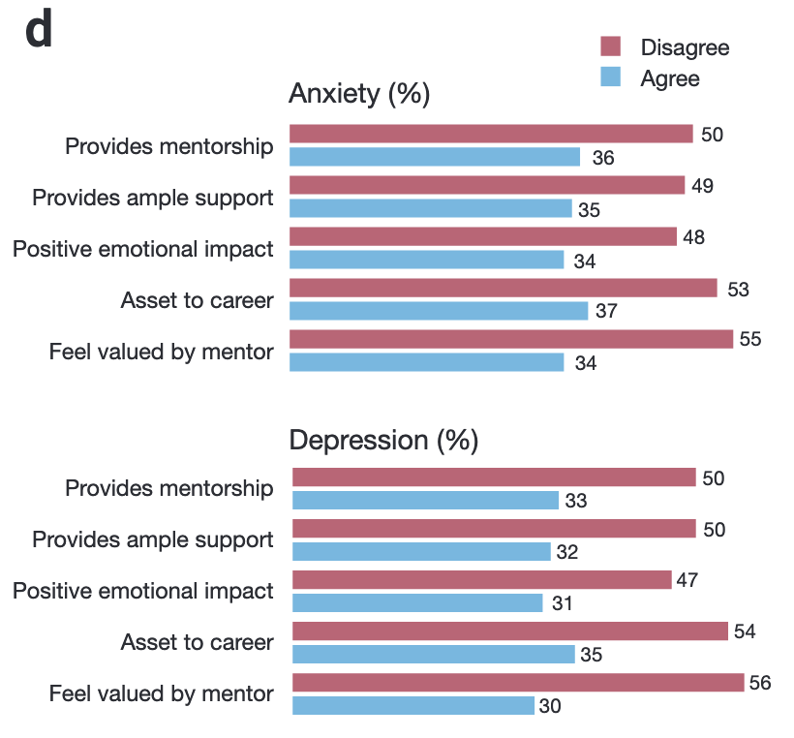
Addressing Hypothesis 2
Among graduate students, students with anxiety and depression note various areas in mentoring that needs to be improved (Evans et al., 2018).

Slide 35

Addressing Hypothesis 2
Learn from child maltreatment research.
Parental training for new parents before first child is born reduced child maltreatment.
Policy change: Mandatory training for graduate advisors (e.g., to obtain a grant that funds grad students, must do training every 5 years).

Slide 36

Addressing Hypothesis 2
Alternatively, have graduate students and early career scientist be supervised by a mentor and a research advisor (i.e., two advisors).
Research advisor focuses on helping the student perform the work and the mentor advisor focuses on student growth and training.
Idea has already been demonstrated to work in education (e.g., my current job!).
Policy change: Institutions should bring in a mentor advisor to guide students and early career scientist rather than put the burden on researchers.

Slide 37

Addressing Hypothesis 2
Role of the mentor advisor:
  Mentor advisor focus on student growth.
  Help students gain skills needed in post grad life (e.g., budget, review, write papers/proposals, giving presentations).
  Address non-academic issues affecting students productivity, learning, and training.
  Mentor advisor would have the personality and training in teaching and mentoring.

Slide 38

Addressing Hypothesis 2
High quality mentorship can benefit the student by:
Addressing missing/weak skills in students (e.g., writing, critical thinking, approach to research).
Creating motivation to efficiently navigate grad school.
Helping students find their best career direction in planetary science.
Advocating for the student and providing support.

Slide 39

Addressing Hypothesis 2
How do university and funding agencies benefit from this idea?
Researchers can spend more of their day/mind on research (publish more and create higher quality work).
Researchers are not forced to become skilled in areas they are not interested in.
Produce more well-trained graduates.
It will not cost university much more money (one mentor could work with 25+ students at once).

Slide 40
Small Cultural Changes: Introducing Appreciation

Slide 41
Homework warning!
Improving mental health means the status quo needs to change. That means we all have work to do!
Homework does not mean you have to make time consuming actions, we will focus on small changes in communication.
Focus on creating SMART goals/homework (Specific, Measureable, Achievable, Relevant, Time-Bound Goals).

Slide 42
Top Contributors to Anxiety among Planetary Scientists

Slide 43
Top Contributors to Depression among Planetary Scientists

Slide 44

Three places to improve communication
Ways to improve appreciation and valuing others:
Showing appreciation
Recognizing strengths
Complimenting people for the process

Slide 45

Showing Appreciation
Gratitude and appreciation can be offered as simple as a sentence with the reason why.
Adding the reason for the appreciation adds sincerity and helps them understand how it helps you.
“Thank you for cleaning the laboratory, it helps all of us to not stress about cleaning before starting our next experiment.”

Slide 46

Showing Appreciation
Like friendship, appreciation is a give and take.
When receiving appreciation, tell them how you felt about it!
“Of course! I’m glad I can help people feel at ease before starting an experiment”.

Slide 47

Recognizing Strengths
Like classwork, in science, we are driven to always get it right and be precise.
Trying to get it right and be perfect can lead to focusing on mistakes, deficits, and weaknesses, even from people who are trying to help.
Not only can we appreciate others and their actions, we can appreciate their strengths.

Slide 48

Recognizing Strengths
Recognizing someone’s strength will help them use it more often and help use it to support areas that need more development.
Example: “You did a great job writing a thorough Introduction section and synthesizing past studies. Let’s do it again in the Discussion and figure out how to integrate past studies with your results.”
Often, we only tell people what they did wrong. Let them know what they did right.

Slide 49

Complimenting the Process
Only complimenting and providing positive comments after achievements can be problematic (can cause people to feel like failures when not achieving something).
Important to also compliment the process.
“Although you didn’t get the grant, you did a great job taking the time to write, and put together a high quality proposal.”
Important to compliment both the process and the achievement.

Slide 50

Homework #1
We reviewed:
  Showing appreciation
  Recognizing strengths
  Complimenting the process
Come up with homework that you would give to yourself to integrate more of these changes in communication (remember your SMART goals)
Example: I’ll make sure to show appreciation to someone at work at least three times a week by the end of the year.
Example: Every time I review a paper, I need to recognize at least 2 strengths by the end of the semester.

Slide 51

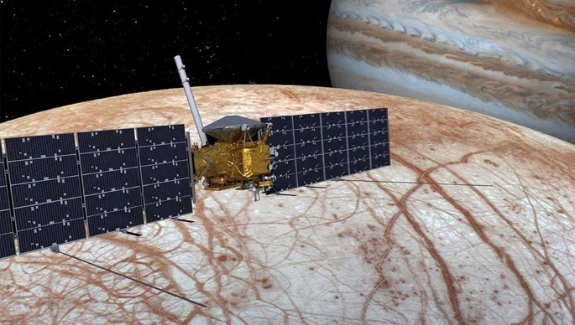
Homework #2
How you will spread what you learned here to others to help with a cultural change?
Example: I will talk to 5 colleagues by the end of the year about how we can create an environment of appreciation and encourage them to do so as well.
If we all work on this behavioral changes together, we can create major changes even before Europa Clipper arrives to the Jupiter system!

Slide 52
Summary of Homework
1. How will you increase your appreciation and recognition of other people’s strengths?
Example: I’ll make sure to show appreciation to someone at work at least three times a week by the end of the year.
Example: Every time I review a paper, I need to recognize at least 2 strengths by the end of the semester.
2. How many people will you teach what you learned here so that we can promote a cultural change?
Example: I will talk to 5 colleagues by the end of the year about how we can create an environment of appreciation and encourage them to do so as well.

Slide 53
Most Common Contributor Among Planetary Grad Students

Slide 54
Most Common Contributor Among Planetary Postdocs

Slide 55
Most Common Contributor Among Planetary Soft Money Researchers

